Slide 1
GoldenFrog series maintenance guide

Slide 2
Contents
1 General information … … … … … … … … … … … 2
2 Installation guide … … … … … … … … … … … … 4
3 Common malfunctions and maintenance … … 13

Slide 3
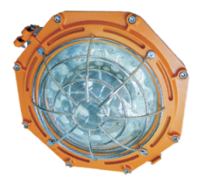
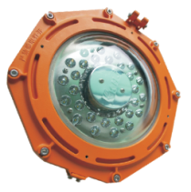
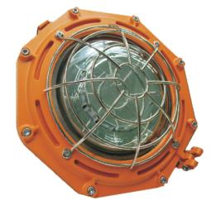
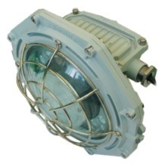
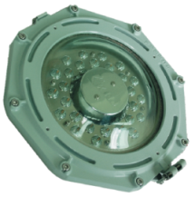
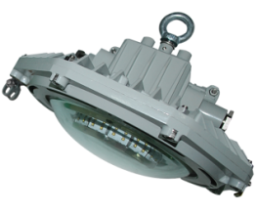
1. Appearance
1.1 Explosion-proof series
Spot light
Low bay
Flood light
1.2 Industrial series
Spot light
Low bay
Flood light

Slide 4
2. Product summary
A. Features
This series adopts LED lighting module which features high efficiency, high lumen output and long lifespan. Adopting integrated design, the lighting fixture is made of high strength aluminum alloy.
Junction box and LED lighting source are isolated to increase the safety and reliability.
B. Main purpose and applicable scope
The explosion-proof series is applicable to the flammable places in oil field, Petroleum industry , petrochemical industry, etc.
The industrial series is applicable to the normal workshop, warehouse etc.
C. The ambient temperature is -40℃to +40℃
D. Certificate
PCEC(China)/MA(china)/CQC(china)/ATEX/IECEX/CE/ROHS

Slide 5
1. Caution
A. Installation and maintenance should be done by professional staff
B. Avoid explosion
a. Ensure that the voltage of power supply is within the range marked on the label
b. Don’t install the product in any flammable places that the temperature is over the temperature level marked on the label
C. Prevent electric shock and burns
a. Forbidden install or maintain with power
b. The enclosure should be earthed reliably
c. Don’t touch the transparent parts to prevent burns when it is power on

Slide 6
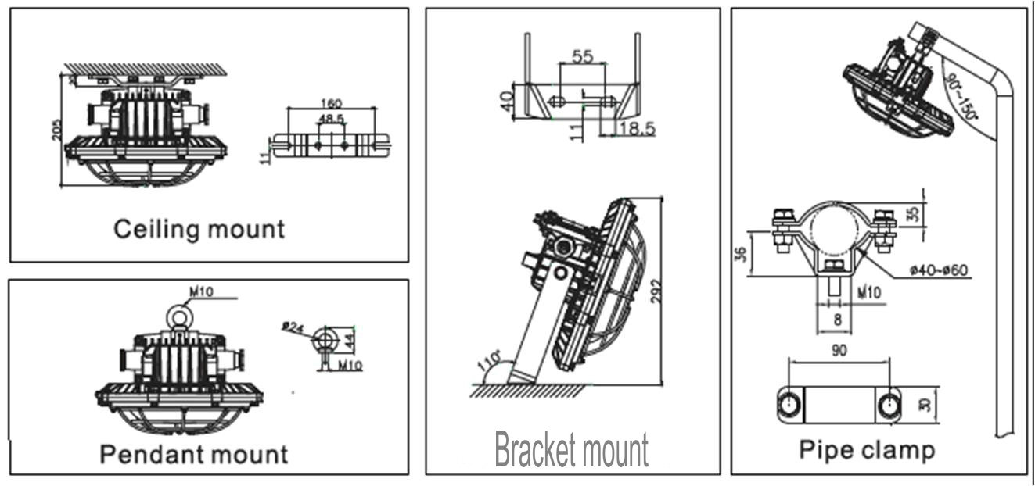
2. Installation
There are 4 mounting types: ceiling mount , pendant mount , bracket mount , pipe clamp mount. Please select the mounting type according to the actual requirement.

Slide 7
2. Installation
A. Ceiling mount
Install 2 expansion bolts at the predetermined position on the ceiling according to the holes in the bracket . Mount the bracket on the enclosure . Connect the bracket to the 2 expansion bolts and fasten them.

Slide 8
2. Installation
B. Pendant mount
Install 1 expansion bolt at the predetermined position on the ceiling according to the ring bolt hole in the enclosure. Mount the ring bolt in the enclosure . Connect the ring bolt to the expansion bolt with wire rope and fasten them.

Slide 9
2. Installation
C. Bracket mount
Install 2 expansion bolts at the predetermined position on the wall or other flat surface according to the holes in the bracket. Mount the bracket on the enclosure . Connect the bracket to the 2 expansion bolts and fasten them.

Slide 10
2. Installation
D. Pipe clamp mount
Mount the A part of the pipe clamp on the enclosure, and fix the B part on the lighting pole. Then connect the A part to the B part with bolts and fasten them.

Slide 11
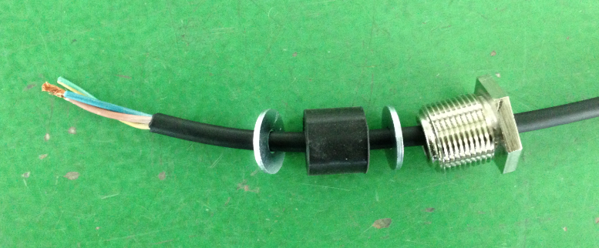
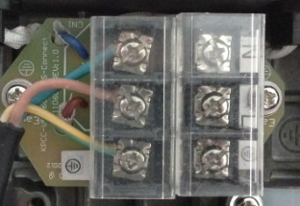
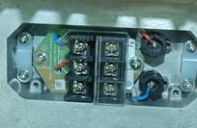
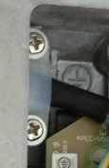
3. Electrical connection
Loosen the inner hexagonal bolts by 5mm screw driver and remove the cover
Loosen the cable gland and insert the cable from outside through the cable gland into the terminal box.
Unlock the screws on the terminal and introduce the wires , then fasten the screws.
Cable should be pressed tightly under the cable anchorage

Slide 12
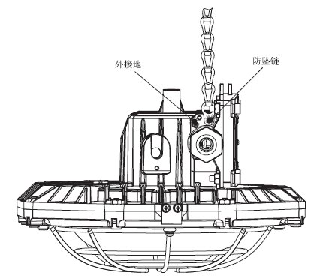
4. Fall proof chain
Fix one end of the chain to the enclosure and the other end to the mounting surface so as to prevent the lighting fixture to fall accidentally.

Slide 13
5. Operation caution
Not use the lighting fixture lacks some parts.
Do not touch the enclosure or glass to avoid the burns to your hands during the operation.

Slide 14
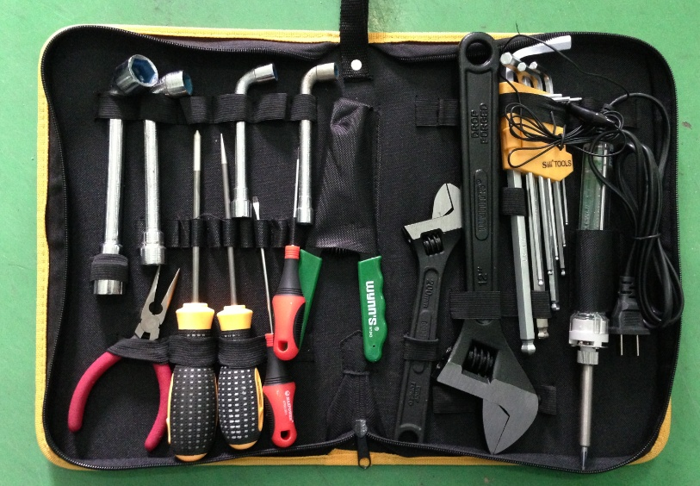
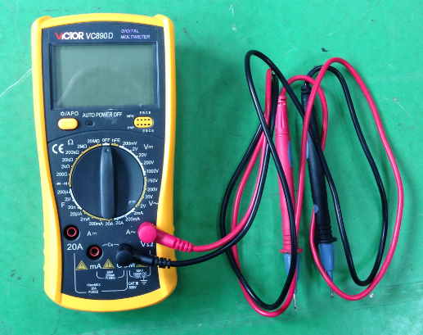
1. Preparation of tools
Common tools：
Philips screwdriver , straight screwdriver , internal hexagonal wrench ,
adjustable spanner , pliers , etc.
Universal meter

Slide 15
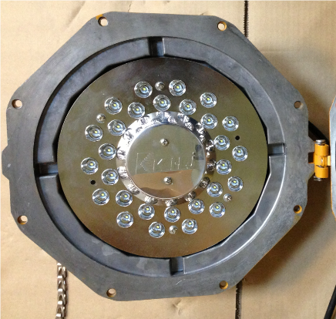
2. Crack on the glass
Analysis: The impact energy on the glass is over 20J that is the max. limit for the toughened glass
Solution: replace the lamp cover ( include the glass )
Steps :
A. loosen the screws with 5mm inner hexagonal wrench , loosen the 2 hinges with a Phillips screwdriver and remove the cracked cover
2 hinges

Slide 16
Steps:
B. Assemble a new lamp cover ( include glass)
Put the lamp cover on the enclosure. Ensure the juts in the lamp cover coincide with the same parts in the enclosure.
Check and ensure there is no dislocation of all parts
Fasten the screws.

Slide 17
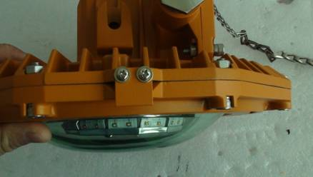
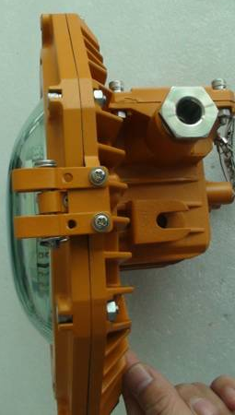
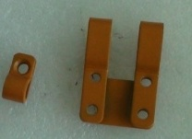
Steps:
C. Fix the hinges
Hinge 2
Hinge 1
Hinge 2
Hinge 1

Slide 18
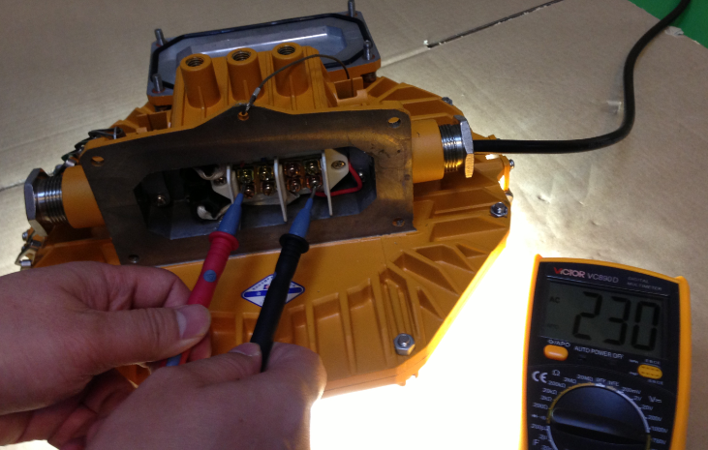
3. Lamp failure
3.1 Analysis: Power supply is failed
Solution: Measure whether the voltage is normal on the terminal block. If there is no power , check the power supply outside. If the voltage is normal , check the circuit inside.
Use the universal meter to measure the terminal block (L and N poles) and compare the value and the rated input voltage on the label.
Remove the cover
Terminal block

Slide 19
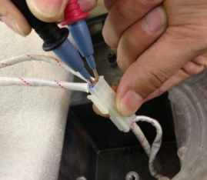
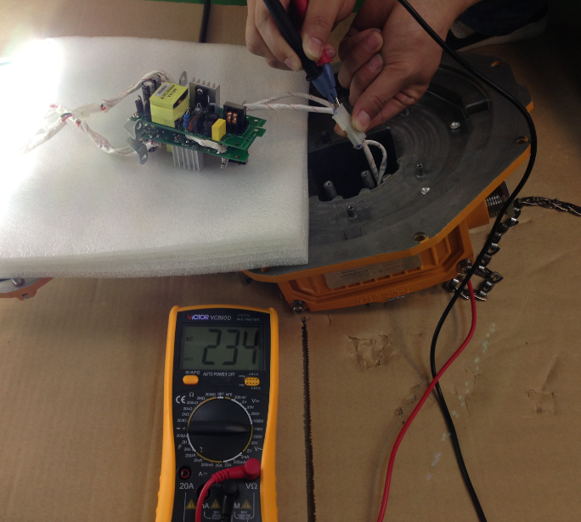
3. Lamp failure
3.2 Analysis: No power on the input terminal of the power supply board
Solution: Measure whether the voltage is normal on the input terminal of the power supply board. If there is no power , check whether there is poor contact from terminal block to the input terminal. If the voltage is normal , check other parts of the board.

Slide 20
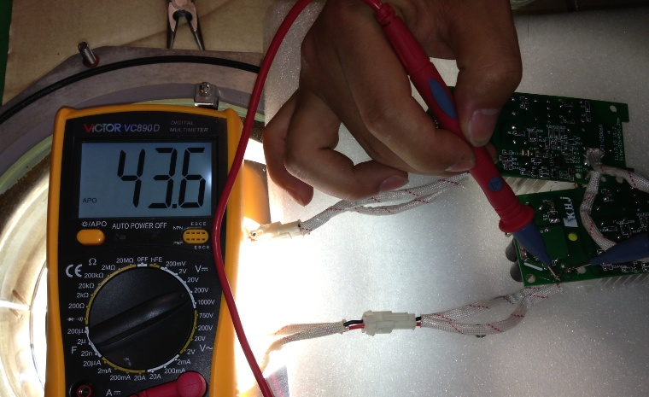
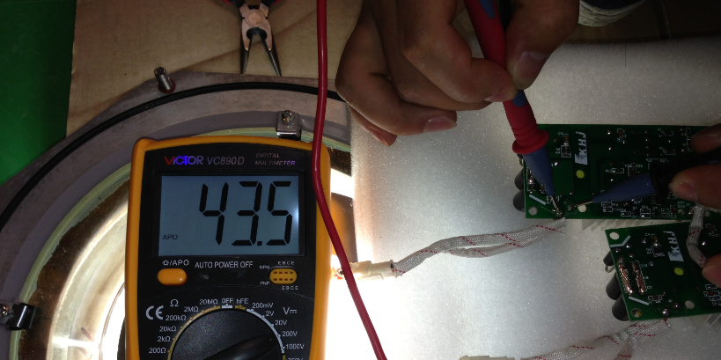
3. Lamp failure
3.2 Analysis: the power supply board is failed
Solution: Observe whether some electronic components are damaged and give off bad smell. If not , measure whether the voltage is normal on the output terminal. If there is no voltage ( DC ) or very low , replace the power supply board . If the output is normal , check the LED board
电压正常

Slide 21
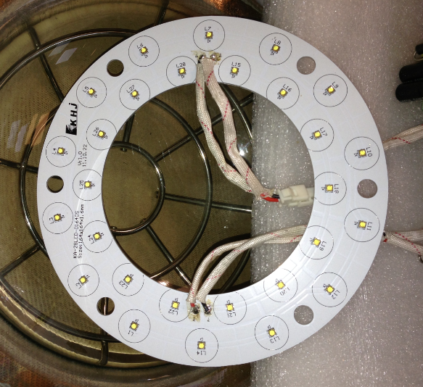
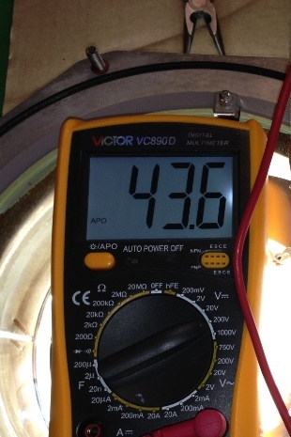
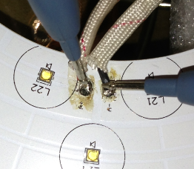
3. Lamp failure
3.2 Analysis: the LED board is failed
Solution: Measure the voltage between “+”and “-”on the LED board . If the voltage is normal , replace the LED board.
If not , check the cables and connector from the power board to the LED board, then measure again.

Slide 22
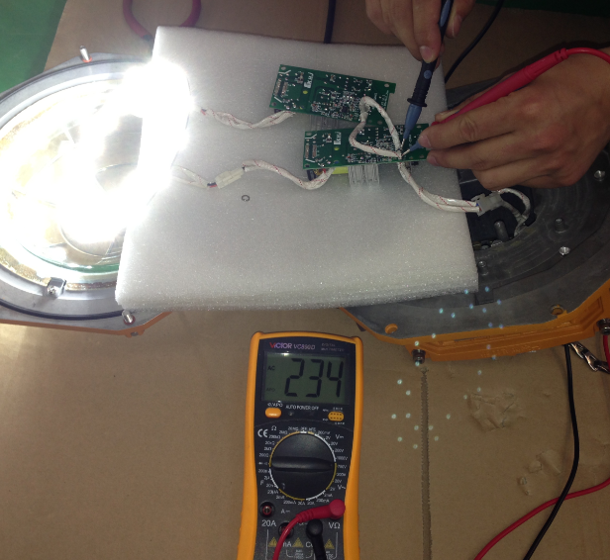
4. Half of the LED failure
4.1 Analysis: one of tow power supply boards is failed
Solution: For this board connected to the failed LED , observe whether some electronic components are damaged and give off bad smell. If not , measure whether the voltage is normal on the output terminal. If there is no voltage ( DC ) or very low , replace this power supply board . If the output is normal , check the LED board
Output terminal
Input terminal

Slide 23
4. Half of the LED failure
4.2Analysis: LED board is failed
Solution: Measure the voltage between “+”and “-”of the input terminal on the failed part of LED board . If the voltage is normal , replace the LED board.
If not , check the cables and connector from the power board to the LED board, then measure again.

Slide 24
5. Some LED chips failure
5.1Analysis: LED board is failed
Solution: :Measure the voltage between “+”and “-”of the input terminal on the failed part of LED board . If the voltage is normal , replace the LED board.
If not , check the cables and connector from the power board to the LED board, then measure again.
电压正常

Slide 25
6. LED flash rapidly
Analysis: Reference to the steps of 3. Lamp failure
Solution:

Slide 26
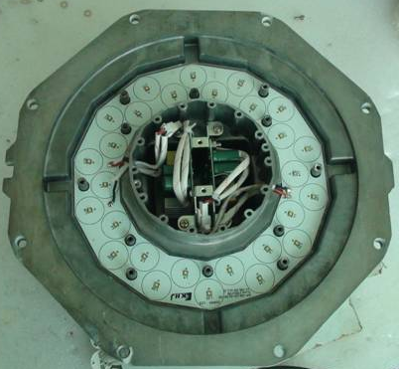
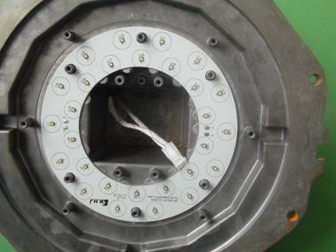
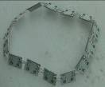
7. How to replace the LED board
14 pieces of small boards and can be replace individually
One integrated board
15°LED board in spot light
80°LED board in low bay
180°LED board in flood light

Slide 27
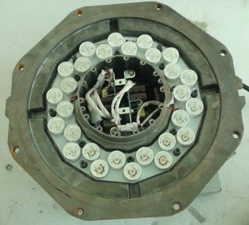
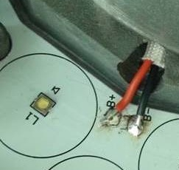
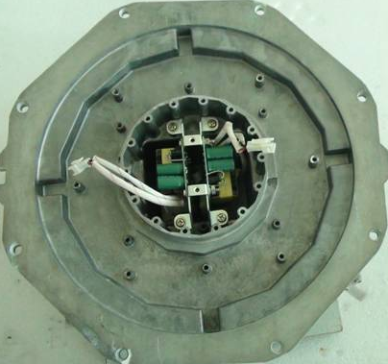
7. How to replace the LED board
7.1 spot light
Unsolder the power cables ( 2 red and 2 black) ）
remove the cover , then, remove the reflectors by turning round the reflector gently and pulling it upwards at the same time
Remove the LED board

Slide 28
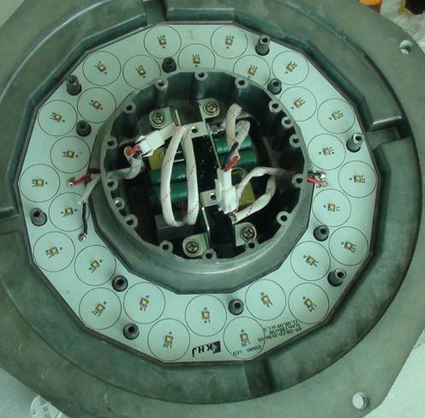
7. How to replace the LED board
7.1 spot light
Insert the LED board into the enclosure
Solder the 4 power cables(2 red and 2 black) at the correct positions.
Insert the reflector son the LED chips and turn round to fix them .

Slide 29
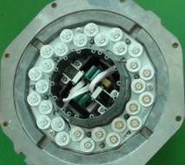
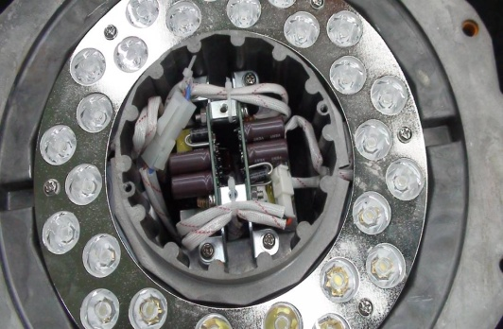
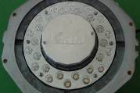
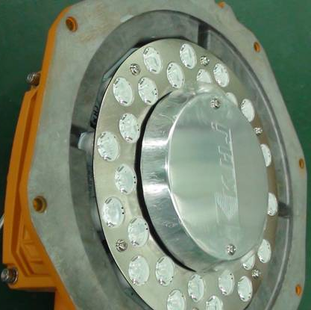
7. How to replace the LED board
7.1 spot light
Screws the decorative cover on the enclosure. Ensure that the marks is consistent with the marks on the enclosure.
Tie up the cables
Put the reflector cover and screws it.

Slide 30
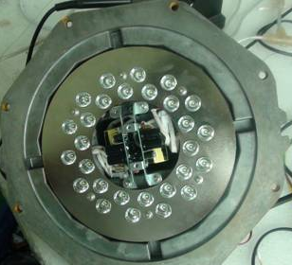
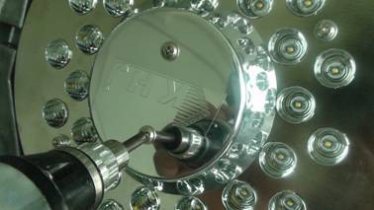
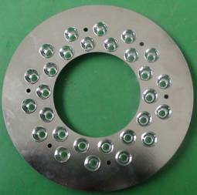
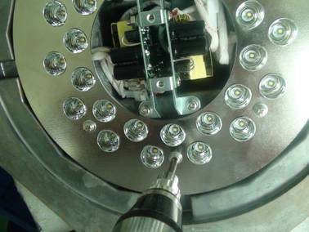
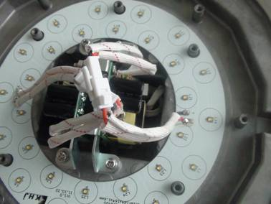
7. How to replace the LED board
7.2 low bay
Power supply board
Remove the lamp cover and decorative cover
reflector plate
Dismantle the reflector plate
LED board

Slide 31
7. How to replace the LED board
7.2 low bay
Disconnect the LED board from the power supply board
Loosen the 6 screws to remove the LED board

Slide 32
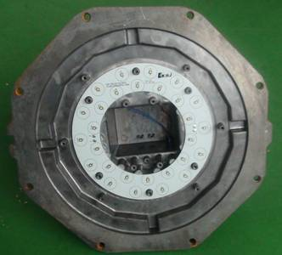
7. How to replace the LED board
7.2 low bay
Screws the new LED board on the enclosure.
Ensure that the direction of marks should be consistent with the marks on the side cover. 与侧盖的字体方向一致
Connect the LED board to the power supply board。

Slide 33
7. How to replace the LED board
7.2 low bay
Screws the decorative cover.
Ensure that the direction of marks should be consistent with the marks on the side cover.
Put the reflector cover on the enclosure and fix it by screws
Assemble the lamp cover

Slide 34
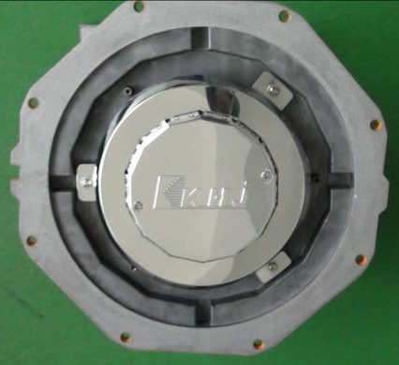
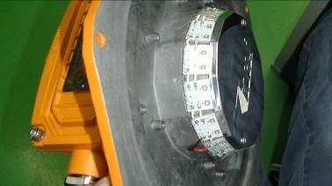
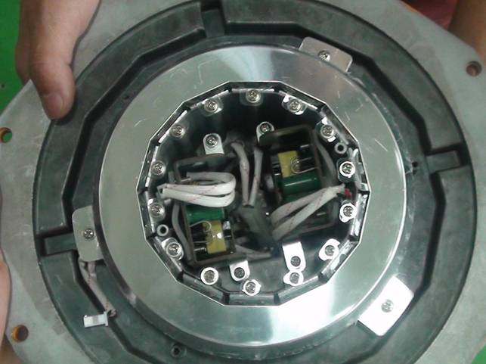
7. How to replace the LED board
7.3 flood light
Remove the lamp cover
Remove the decorative cover
Remove the reflecting ring

Slide 35
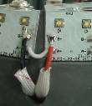
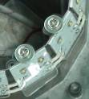
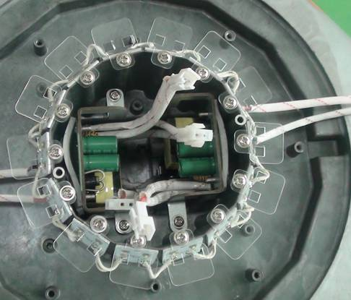
7. How to replace the LED board
7.3 flood light
Unsolder the power cables
Loosen the screws of the LED board. Do not lose the insulation spacer
Remove the LED board

Slide 36
7. How to replace the LED board
7.3 flood light
Solder the power cables on the correct positions on the new LED board
Screws the LED board on the enclosure . Do not forget the insulation spacer
Fix the reflecting ring
Fix the decorative cover

Slide 37
7. How to replace the LED board
Caution：
The lighting fixture should be energized more than 2 hours before tighten the screws to evaporate the water inside , then, shut down and tighten all screws.

Slide 38
8. How to replace the power supply board
8.1 spot light & low bay
Disconnect the power board from the LED board and terminal block. Loosen the screws and remove the board
Remove the decorative cover
Remove the lamp cover
Dismantle the 2 boards and bracket

Slide 39
8. How to replace the power supply board
8.1 spot light & low bay
Open the package of the new power supply board, install it by reverse operation of the 8.1 spot light & low bay
Caution：
The lighting fixture should be energized more than 2 hours before tighten the screws to evaporate the water inside , then, shut down and tighten all screws.

Slide 40
8. How to replace the power supply board
8.2 flood light
Remove the lamp cover
Disconnect the power board from the LED board and terminal block. Loosen the screws and remove the board
Remove the decorative cover
Dismantle the 2 boards and bracket

Slide 41
8. How to replace the power supply board
8.2 flood light
Open the package of the new power supply board, install it by reverse operation of the 8.2 flood light
Caution：
The lighting fixture should be energized more than 2 hours before tighten the screws to evaporate the water inside , then, shut down and tighten all screws.

Slide 42
THANKS！

